Slide 1
Overview of ARM Architecture
Sujit Reddy Thumma
December 2010

Slide 2
Agenda
Caches
Memory Management
Synchronization Barriers

Slide 3
What is a Cache?
Small fast memory, local to the processor
Automatically holds copies of recently accessed memory locations
Which memory locations are cached is controlled via MMU or MPU
Relies on memory re-use to improve performance
Improves performance for slow and narrow memory
Reduces bus bandwidth requirements and so power consumption

Slide 4
Cache Access
When the core requests an access to cacheable memory, the cache will be searched first.
The requested memory address is split into Tag, Index and offset fields.
The Index field is used to locate the cache line of interest
The Tag is compared against the saved tag for that particular line
The Offset field specifies a particular word in the cache line
Tag mismatch indicates Cache Miss
Will result in an access to external memory
Data is copied into the cache one line at a time (Cache Linefill)
A Cache line is always aligned to the cache line size (Offset is zero)
Access will be delayed
Allocated bits for each field depend on the structure and size of the cache. On ARMv7 cores caches are configurable
Direct Mapped Cache
Multiple memory locations will contend for the same cache line (same Index)
The saved tag will identify which memory location the line contains
Better to use Set Associative Cache

Slide 5
Set Associative Cache
Set Associative Caches reduce contention problems
Consists of Directly Mapped Caches in parallel (each referred to as a way)
More Complex to implement and requires more comparison logic
Each memory location now has ‘n’ possible locations
Where ‘n’ is determined by the number of Cache ways implemented
Scorpion uses 16way L1 and 4way L2 caches
Victim counter selects which cache way to use for an Eviction/Linefill
Two strategies – Round Robin, Random
Use unoccupied line in preference to Eviction scheme
ARM cores doesn’t implement LRU (Least Recently Used) algorithm for eviction.

Slide 6
ARM Cache Features
Harvard Implementation for L1 Cache
Cache Lockdown
Pseudo-random and Round-Robin replacement strategies
Non-blocking data cache
Streaming, Critical-Word-First
ECC or parity checking

Slide 7
Caching Modes
Caching modes for v6 and v7 cores
Write-through, Read allocate
Write-back, Read allocate
Write-back, Write allocate
Cache Type/Size registers defines these modes
Write-Through Mode:
Write updates both the Cache and external memory system
No dirty data is produced
Write-Back Mode:
Cache Hit – Updates the Cache only (data marked as Dirty)
Cache Miss – Write propagates to the external memory through write buffer (only for read allocate)
Cache Miss – write allocate will result in a Cache line fill

Slide 8
Cache Coherency
When Cache need to be coherent with memory?
Application executes a self modifying code
Application changes memory attributes at runtime
Application preloads a locked cache way
Debugging of a cached processor
How to ensure coherency?
L1 instruction cache
Simply perform cache invalidation
L1 data cache, write-back mode
Perform cache clean to update memory with dirty data
Perform cache invalidate to force the cache to refill from memory
L1 data cache, write-through mode
Perform cache invalidate
L2 Unified Cache, write-through/write-back mode
Same as L1 Cache

Slide 9
Agenda
Caches
Memory Management
Synchronization Barriers

Slide 10
Memory Management
The memory map of a typical system is partitioned into logical regions
Each region may require different memory attributes
Access permissions
Unprivilaged mode: User
Privilaged modes: Supervisor, Undefined, Abort, FIQ, IRQ, System, Monitor
Instruction fetches from a region can be disabled by setting the Execute Never (XN) attribute
Memory Types
Controls Memory access ordering rules
Controls Caching and buffering behavior
Three mutually exclusive memory types
Normal
Device
Strongly-ordered
Notes:
Make font size 20

Slide 11
Memory Types – Normal
Normal memory implements a “weakly ordered” memory model
The Normal type is used for code and most data regions
Normal memory gives best performance
Allows the core to re-order, repeat and merge accesses
Allows buffering of writes
Instruction fetches are only permitted to Normal regions
Normal memory allows additional attributes
Caching options – Uncached, Write-Through, Write-Back
Shared – Non-Shareable, Inner Shareable, Outer Shareable
Notes:
Need to update notes….
Make font size 20 now 18

Slide 12
Memory Types – Device
The Device type is used for regions where accesses can have side-effects
Typically used only for peripherals
Device type imposes more restrictions on the core
Must be issued in order with respect to other device accesses
Accesses cannot be merged, re-sized or repeated
Cannot be Cached
Buffering is allowed
Device regions can be shared or non-shared
Device memory accesses are less efficient compared to Normal memory
Notes:
Example- a write to a peripherals control register may trigger an interrupt as a side effect
Ordering is only enforced between device accesses with the same shared attribute
-- Ordering is done at compile time so need synchronization barriers

Slide 13
Memory Types – Strongly-ordered
Imposes the most restrictions on the core
Must be issued in order with respect to all other Strongly-ordered and Device accesses
Cannot be merged, re-sized or repeated
Cannot be cached or buffered
Give worst performance
Usage should be limited to cases which require implicit memory barriers
The Use of explicit memory barrier instructions may yield better performance
Strongly-ordered memory is always a shared memory
In v7, a Strongly-ordered access is only guaranteed to complete in program order with respect to Device and Strongly ordered only, not Normal
Notes:
Need to change fonts…
Need to know the answers for the one in red.

Slide 14
Memory Barriers
Memory Barriers provide a mechanism to force access order and access completion
Useful in situations where the memory types do not enforce ordering
Two instructions are available for this purpose
DMB – Data Memory Barrier
Ensures that all data accesses occurring before the barrier instruction will complete before explicit accesses following it
DSB – Data Synchronization Barrier
Ensures that no instruction after the barrier executes until all the pending explicit data access, cache maintenance and TLB maintenance operations have completed
Notes:
Font size…
Example of DMB – Using DMB just before returning from an interrupt handler ensures that
The interrupt controller register is written and interrupt source is cleared before returning from exception

Slide 15
Role of MMU
MMU handles translation of virtual addresses to physical addresses
Provides hardware to read translation tables in memory – called table walk
CP15 Table Base Registers (TTBR) store physical base addresses of tables
Translation Look-aside Buffers (TLBs) cache recent translations
Core can have separate instruction and data TLBs, or a shared unified TLB
When MMU is enabled all accesses by the core are passed through it
MMU will use cached translations from the TLB(s) or perform a table walk
Translation must occur before cache look-up can complete
Notes:
Make a diagram here
Font…

Slide 16
Translation Tables
First-level Translation Table
Consists of 4096 descriptors, each describing 1MB of virtual memory space (total 4GB)
The translation table is indexed using bits 31:20 (12 bits) of the Virtual Address
The descriptor contains bits 31:20 of the physical address that the section maps to or, the physical base address of Second-level table
Second-level Translation Table
Subdivides 1MB section into 4K pages ( total 256 entries)
Second-level tables are indexed using the VA offset into the 1MB
Second-level descriptor contains the Physical Address (PA)
Physical Address is calculated using VA (31:20) to first-level and remaining 20 bits gives offset to 4KB page
Notes:
Add a diagram for this…

Slide 17
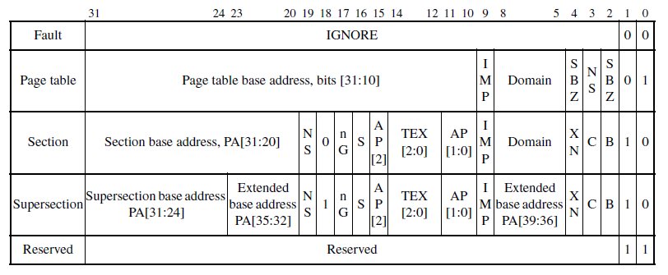
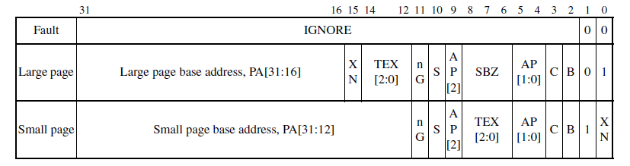
Format of Descriptors

Slide 18
Enabling MMU
Write translation tables to memory
Update CP15 Translation Table Base Control Register (TTBCR)
Update CP15 TTBR0 and TTBR1
Update CP15 Domain Access Control Register (DACR)
Invalidate TLBs, Caches and branch target buffer
Enable MMU and optionally caches and branch prediction
Notes:
Must provide atleast a first level table with valid entries for the area of code being executed
TTBCR controls partition of virtual memory between TTBR0&1
TTBR0&1 set to physical base address
DACTR used to set to either client or manger
Invalidate caches TLBs are not guaranteed on Reset on v7 cores.

Slide 19
Modifying the page tables
The TLBs keep cached copies of recently used translations so invalidate TLBs when a page table is modified (CP15 registers)
Steps to update TLBs
Issue a DSB to ensure out standing accesses are completed
Modify page tables
Invalidate TLBs
Issue a DSB to ensure subsequent accesses do not start before TLB invalidate completes
If the region being modified contains instructions, the branch target buffer must also be invalidated

Slide 20
Task Switching
The virtual address space is usually split in two
Kernel Space
Kernel code and Peripherals
Remains constant across applications
Application Space
Application Specific
Changes on context switch
Task switching introduces an overhead
TLBs need to be flushed
Need to issue DSB before and after updating TTBR1 and Context ID register
Branch target history should be flushed
Caches may need to be flushed

Slide 21
Reduce Task Switching overhead
V7-A cores provide mechanisms to reduce the overhead
Global and Non-Global page table entries
Application Space Identifiers (ASIDs)
ASID is used to identify the currently running task
8bits are allocated in Context ID register
Page table entries can be marked as Global or Non-Global (nG bit)
For Non-Global entries the TLB will store the translation and current ASIDs value
TLB hit only when ASID matches
Can be used to remove need to flush the TLB on context switch
TTBR0 is typically used for OS and peripherals
TTBR1 is typically used for applications

Slide 22
Agenda
Caches
Memory Management
Synchronization Barriers

Slide 23
Synchronization Barriers
Classic ARM processors execute instructions and data accesses in program order
The latest processors are capable of optimizing order of execution, in some situations this leads to unpredictable behavior
DSB - completes when all instructions before this instruction complete
DMB - ensures that all explicit memory accesses before the DMB instruction complete before any explicit memory accesses after the DMB instruction start
ISB - flushes the pipeline in the processor, so that all instructions following the ISB are fetched from cache or memory, after the ISB has been completed.

Slide 24
Where to Insert these instructions? (1)
Mutexes
Perform a DMB operation:
between acquiring a resource (lock_mutex) and making access to that resource
before making resource available (unlock_mutex)
Perform a DSB operation:
After updating synchronization variable (unlock_mutex) so as to be visible to all processors
Notes:
lock_mutex ; Is mutex locked? LDREX r1, [r0] ; Check if locked CMP r1, #LOCKED ; Compare with "unlocked"
WFEEQ ; Mutex is locked, go into standby
BEQ lock_mutex ; On waking re-check the mutex
; Attempt to lock mutex MOV r1, #LOCKED STREX r2, r1, [r0] ; Attempt to lock mutex CMP r2, #0x0 ; Check whether store completed BNE lock_mutex ; If store failed, try again
DMB ; Required before accessing protected resource
BX lr
unlock_mutex DMB ; To ensure accesses to protected resource have completed MOV r1, #UNLOCKED ; Write "unlocked" into lock field STR r1, [r0] DSB ; To ensure update of the mutex occurs before other CPUs wake
SEV ; Send event to other CPUs, wakes any CPU waiting on using WFE BX lr

Slide 25
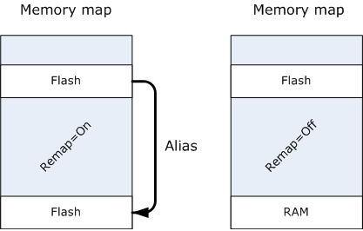
Where to Insert these instructions? (2)
Memory remapping
Use DMB and ISB instructions
Notes:
Consider a situation where your reset handler/boot code lives in Flash memory (ROM), which is aliased to address 0x0 to ensure that your program boots correctly from the vector table, which normally resides at the bottom of memory (see left-hand-side memory map).
After you have initialized your system, you may wish to turn off the Flash memory alias so that you can use the bottom portion of memory for RAM (see right-hand-side memory map). The following code (running from the permanent Flash memory region) disables the Flash alias, before calling a memory block copying routine (e.g., memcpy) to copy some data from to the bottom portion of memory (RAM).
MOV r0, #0 MOV r1, #REMAP_REG STR r0, [r1] ; Disable Flash alias DMB ; Ensure completion with Data Memory Barrier BL block_copy_routine() ; Block copy code into RAM ISB ; Ensure pipeline flush with Instruction Syncronization Barrier BL copied_routine() ; Execute copied routine (now in RAM)
Without the DMB between the store (STR) and the branch with link (BL) instructions, there is no guarantee that the store out to memory will complete before the block copying routine starts writing to the bottom portion of memory, because the block copying routine can execute while the data is draining through the write buffer. The DMB causes all instructions before the DMBto complete. The ISB prevents instructions being fetched from RAM before the block copying routine completes.

Slide 26
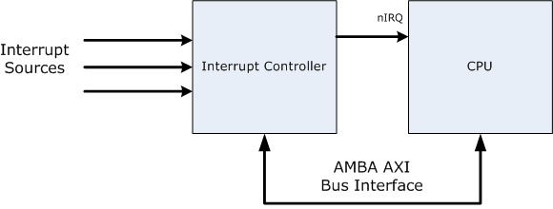
Where to Insert these instructions? (3)
Interrupts
Use DSB before interrupts are enabled in interrupt handler
Notes:
The diagram below shows a system containing an interrupt controller based on the Generic Interrupt Controller (GIC) architecture. When the interrupt controller detects an incoming interrupt, it signals this by asserting the nIRQ input signal to the processor. This triggers a series of events that end up with the processor executing its interrupt handler, with IRQinterrupts masked (it ignores any further changes to the nIRQ input).
The example interrupt handler below acknowledges an interrupt by reading the Interrupt Acknowledge Register (IAR). As well as returning the ID of the highest priority pending interrupt, this causes the interrupt controller to deassert the nIRQ input to the processor. After this, the handler needs to re-enable interrupts, so that an interrupt with a higher priority can pre-empt the current one.
interrupt_handler ; ... LDR r0, =GIC_CPUIF_BASE ; Get interrupt controller base address LDR r1, [r0, #0x0c] ; Read IAR - this deasserts nIRQ DSB ; Ensure memory accesses complete before continuing CPSIE i ; Enable interrupts ; ... RFE sp! ; Return from interrupt handler
In this sequence, correct operation requires that the read from the IAR completes before the CPSIE instruction enables IRQinterrupts. Because there are no data dependencies between these two instructions, the cpu may execute the CPSIE before the LDR completes. This could result in the processor incorrectly responding to the same interrupt again. Therefore you needto insert a DSB as shown in the above example.

Slide 27
Where to Insert these instructions? (4)
Self-modifying code
Must be precede by an ISB, because the pre-fetch unit pipeline and the core pipeline may contain out-of-date instructions
Notes:
Self-modifying code sequences must be preceded by an ISB, because the prefetch unit pipeline and the core pipeline may contain out-of-date instructions.
The example below shows a block of code being copied from ROM to RAM, and then branched to and executed.
Overlay_manager ; ... BL block_copy ; Copy new routine from ROM to RAM B relocated_code ; Branch to new routine
If you have branch prediction enabled, and you are relocating code in memory like in the above example, the processor could predict that the second branch instruction will be taken and begin fetching instructions from an another routine, causing the processor to execute code from the older routine, rather than the new one. This issue could occur if the block copying routine and the branch to the new routine are located in close proximity to each other.
To ensure that this optimization does not occur, you should insert an ISB before any newly relocated code begins executing, to ensure that the prefetch buffer is flushed before the processor continues fetching instructions:
Overlay_manager ; ... BL block_copy ; Copy new routine from ROM to RAM ISB ; Ensure pipeline flush with Instruction Syncronization Barrier B relocated_code ; Branch to new routine
If the memory you are performing the block copying routine on is marked as 'write-back cacheable', then you should ensure that this memory is written back to main memory by cleaning the data cache. Also, the instruction cache will need to beinvalidated so that the processor does not execute any other 'cached' code.
Overlay_manager ; ... BL block_copy ; Copy new routine from ROM to RAM DMB ; Ensure memory accesses complete before continuing data_cache_clean ; clean the cache so that the new routine is written out to memory instruction_cache_invalidate ; invalidate the instruction cache so that the old routine is no longer cached DSB ; Ensure completion of cache clean and invalidation before any further memory accesses ISB ; Ensure pipeline flush with Instruction Syncronization Barrier B relocated_code ; Branch to new routine
Similar situations where you may require a barrier are:
A Just-In-Time (JIT) compiler, for example, converting Jazelle bytecode into native ARM code
A post linker/loader which relocates code into memory at run-time.

